Slide 1

Cardiovascular Anatomy
The cardiovascular system consists of the heart and blood vessels that transport blood
through the body

Slide 2
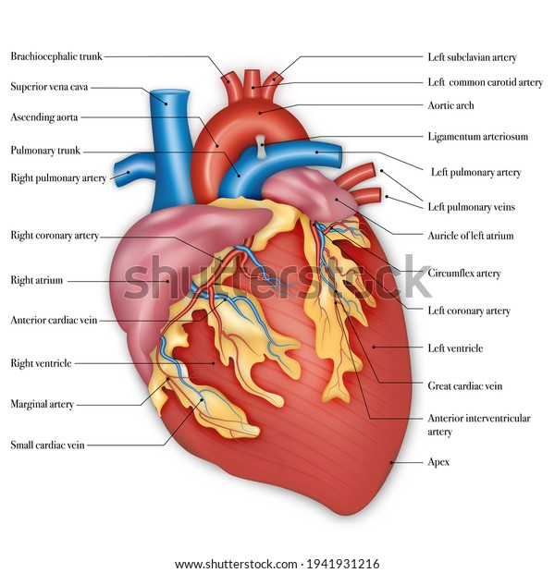
Diagram of Heart

Slide 3
Word Meaning
Atrium Upper right or left chamber of heart
Endocardium Membrane lining the cavities of the heart
Epicardium Membrane forming the outer layer of the heart
Myocardium Heart Muscle
Ventricle Lower right and left chamber of the heart

Slide 4
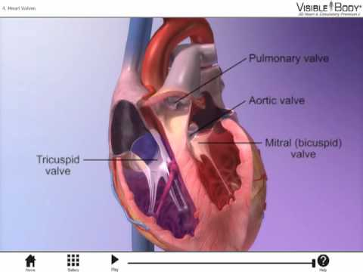
Heart Valves
There are four valves in heart
Aortic Valve
Mitral Valve
Pulmonary semilunar valve
Tricuspid valve

Slide 5
Blood Vessels
Arteries vessels that carry blood from the heart to arterioles
Aorta large artery that is the main truck of the arterial systems
Arterioles small vessels that receive blood from the arteries
Capillaries tiny vessels that join arterioles and venules
Veins Vessels that carry blood from the heart the venules
Venules Small vessels that gather blood from the capillaries into the veins

Slide 6
Type of Blood Pressure
Diastole to expand, period in the cardiac cycle when blood enters the relaxed ventricle from the atria
Systole to contract
Normotension normal blood pressure
Hypotension low blood pressure
Hypertension high blood pressure

Slide 7
Symptomatic Terms
atherosclerosis Build of fatty substance with the walls of arteries
thrombus a stationary blood clot
embolus a clot carried in the bloodstream
stenosis narrowing of a part
claudication limping, pain in a limb, especially the calf area
palpitation Subjective experience of skipping or racing heartbeats
vegetation An abnormal growth of tissues around a valve
Myocarditis inflammation of myocardium muscles
phlebitis Inflammation of a vein
DVT Deep Venous Thrombosis

Slide 8
Operative Terms
CABG Coronary artery bypass grafting
Valvuloplasty repair of a heart valve
Arteriotomy an incision into an artery
Thrombectomy incision into an artery for the removal of a thrombus
Defibrillator Device that delivers the electrical stimulus in defibrillation
ICD Battery operated device with rate sensing leads that stop tachycardia
Pacemaker a device that use to treat slow heart beat

